Slide 1
Linguistics 200, Week 4
Day 1: Consonants

Slide 2
Today
Next Time
Basic Properties of Consonants
Consonant Systems:
English
Spanish
Swahili
Arabic
Working on a Consonant System for Dorgon
Pick five non-English consonants that you really like, using ipachart.com
Compile all of the names you've created for your culture, to give you a starting point for your consonant system

Slide 3
What is in Component 2?
Consonants
Vowels
Phonotactics
Prosody

Slide 4
Warm-up with your Group
There are 21 consonants in English, because there are 21 consonants in the English alphabet
True
False
What are the three properties of consonants? Choose an English consonant, then visit ipachart.com to identify the values of these properties.
How does understanding the properties of consonants help us as conlangers? What might we achieve through breaking or deviating from these properties in our own conlang?

Slide 5
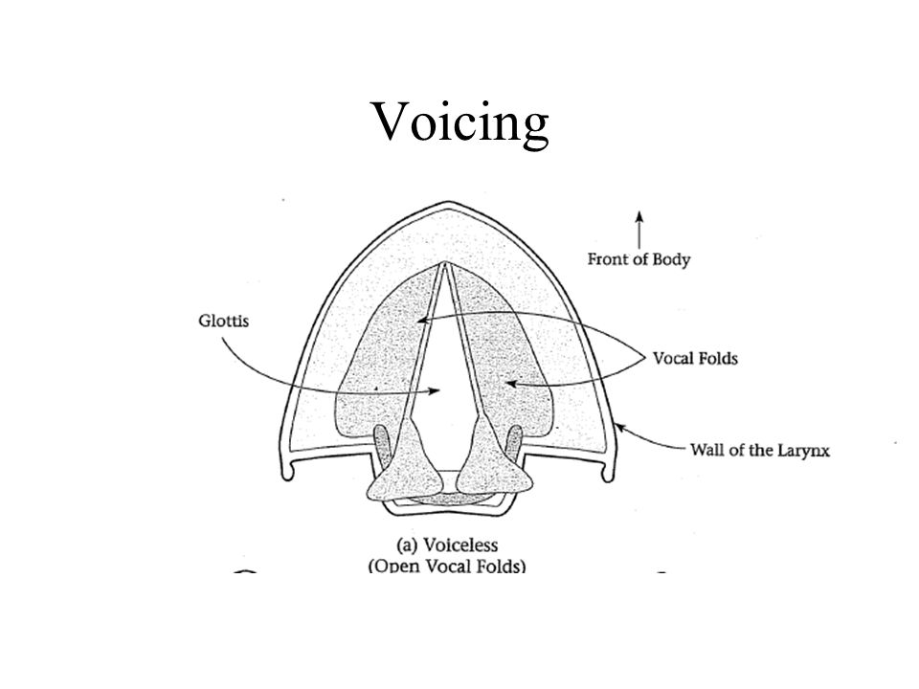

Slide 6
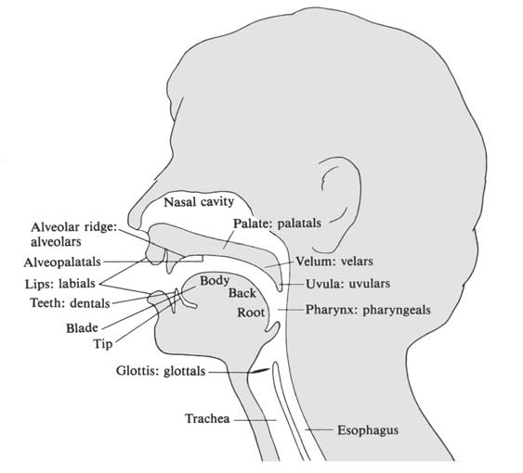

Slide 7
 | Bilabial | Labiodental | Interdental | Alveolar | Alveopalatal | Palatal | Velar | Glottal
Stop voiceless voiced | p b |  |  | t d |  |  | k g | ʔ
Nasal | m |  |  | n |  |  | ŋ
Fricative voiceless voiced |  | f v | θ ð | s z | ʃ ʒ |  |  | h
Affricate voiceless voiced |  |  |  |  | t͡ʃ d͡ʒ
Glide | w |  |  |  |  | j
Liquid |  |  |  | r, l

Slide 8
 | Bilabial | Labiodental | Interdental | Alveolar | Alveopalatal | Palatal | Velar | Glottal
Stop voiceless voiced | p b |  |  | t d |  |  | k g | ʔ
Nasal | m |  |  | n |  |  | ŋ
Fricative |  | f v | θ ð | s z | ʃ ʒ |  |  | h
Affricate voiceless voiced |  |  |  |  | t͡ʃ d͡ʒ
Glide | w |  |  |  |  | j
Liquid |  |  |  | r, l
Voicing
Place
Manner

Slide 9
 | Bilabial | Labiodental | Interdental | Alveolar | Alveopalatal | Palatal | Velar | Glottal
Stop voiceless voiced | p b |  |  | t d |  |  | k g | ʔ
Nasal | m |  |  | n |  |  | ŋ
Fricative |  | f v | θ ð | s z | ʃ ʒ |  |  | h
Affricate voiceless voiced |  |  |  |  | t͡ʃ d͡ʒ
Glide | w |  |  |  |  | j
Liquid |  |  |  | r, l
voiceless

Slide 10
 | Bilabial | Labiodental | Interdental | Alveolar | Alveopalatal | Palatal | Velar | Glottal
Stop voiceless voiced | p b |  |  | t d |  |  | k g | ʔ
Nasal | m |  |  | n |  |  | ŋ
Fricative |  | f v | θ ð | s z | ʃ ʒ |  |  | h
Affricate voiceless voiced |  |  |  |  | t͡ʃ d͡ʒ
Glide | w |  |  |  |  | j
Liquid |  |  |  | r, l
voiceless
alveolar

Slide 11
 | Bilabial | Labiodental | Interdental | Alveolar | Alveopalatal | Palatal | Velar | Glottal
Stop voiceless voiced | p b |  |  | t d |  |  | k g | ʔ
Nasal | m |  |  | n |  |  | ŋ
Fricative |  | f v | θ ð | s z | ʃ ʒ |  |  | h
Affricate voiceless voiced |  |  |  |  | t͡ʃ d͡ʒ
Glide | w |  |  |  |  | j
Liquid |  |  |  | r, l
voiceless
alveolar
stop

Slide 12
 | Bilabial | Labiodental | Interdental | Alveolar | Alveopalatal | Palatal | Velar | Glottal
Stop voiceless voiced | p b |  |  | t d |  |  | k g | ʔ
Nasal | m |  |  | n |  |  | ŋ
Fricative voiceless voiced |  | f v | θ ð | s z | ʃ ʒ |  |  | h
Affricate voiceless voiced |  |  |  |  | t͡ʃ d͡ʒ
Glide | w |  |  |  |  | j
Liquid |  |  |  | r, l
Voicing
Place
Manner

Slide 13
 | Bilabial | Labiodental | Interdental | Alveolar | Alveopalatal | Palatal | Velar | Glottal
Stop voiceless voiced | p b |  |  | t d |  |  | k g | ʔ
Nasal | m |  |  | n |  |  | ŋ
Fricative |  | f v | θ ð | s z | ʃ ʒ |  |  | h
Affricate voiceless voiced |  |  |  |  | t͡ʃ d͡ʒ
Glide | w |  |  |  |  | j
Liquid |  |  |  | r, l
Voicing
Place
Manner

Slide 14
 | Bilabial | Labiodental | Interdental | Alveolar | Alveopalatal | Palatal | Velar | Glottal
Stop voiceless voiced | p b |  |  | t d |  |  | k g | ʔ
Nasal | m |  |  | n |  |  | ŋ
Fricative |  | f v | θ ð | s z | ʃ ʒ |  |  | h
Affricate voiceless voiced |  |  |  |  | t͡ʃ d͡ʒ
Glide | w |  |  |  |  | j
Liquid |  |  |  | r, l
Voicing
Place
Manner

Slide 15
 | Bilabial | Labiodental | Interdental | Alveolar | Alveopalatal | Palatal | Velar | Glottal
Stop voiceless voiced | p b |  |  | t d |  |  | k g | ʔ
Nasal | m |  |  | n |  |  | ŋ
Fricative voiceless voiced |  | f v | θ ð | s z | ʃ ʒ |  |  | h
Affricate voiceless voiced |  |  |  |  | t͡ʃ d͡ʒ
Glide | w |  |  |  |  | j
Liquid |  |  |  | r, l
b
f
h
ʔ
ʒ

Slide 16
Let’s take a look at another language: Spanish
Spanish:
https://en.wikipedia.org/wiki/Help:IPA/Spanish
https://www.ipachart.com/

Slide 17
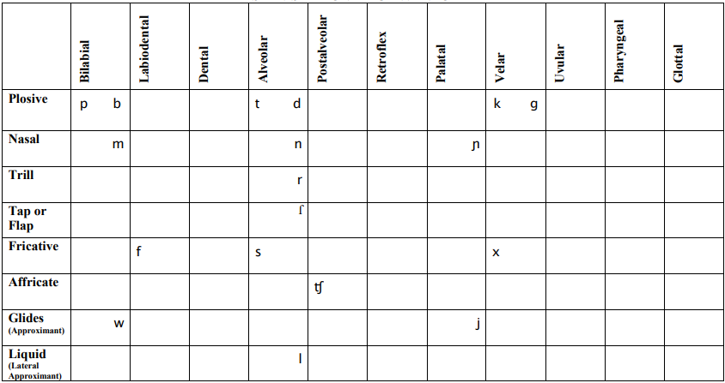

Slide 18
Let’s take a look at another language: Swahili
Swahili:
https://www.youtube.com/watch?v=zyup0YLKCvw
https://www.ipachart.com/

Slide 19
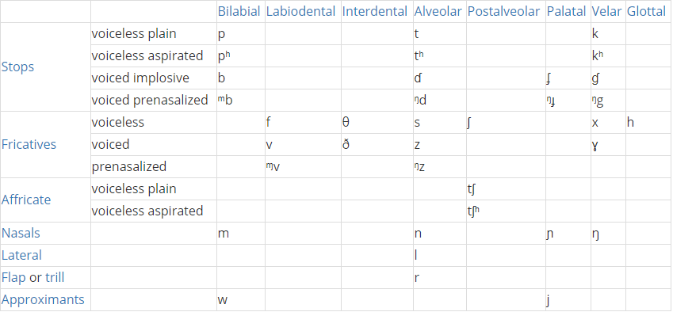

Slide 20
Let’s take a look at another language: Arabic
Arabic:
https://www.youtube.com/watch?v=lkvY_eWetdQ
https://www.ipachart.com/

Slide 21
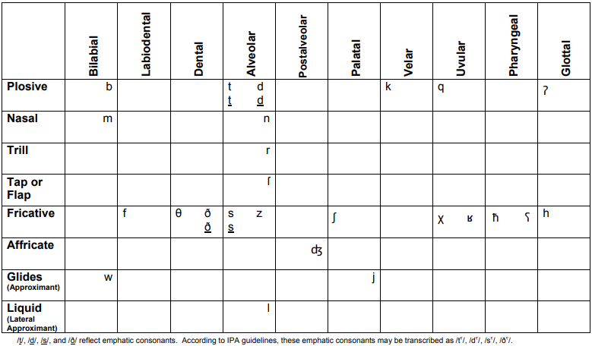

Slide 22
Discuss in your groups: which types of sounds do these four systems all have?
(Note: plosive = stop)

Slide 23
Dorgons – Let's make a consonant system
What words do we already have from Elijah?
Zenasath [ˈzinəsæθ]
Cindor [ˈsɪndɔɹ]
Kdasion [ˈkdæsiɑn]
Dorgon [ˈdɔɹgɑn]
Galasiul [gəˈlæsiəɫ]
Gzenian [ˈgzɛniɑn]
Dumbledimpf [ˈdʌmbl̩dɪmpf]
(note: these word have an American English pronunciation – we’ll need to modify them to produce an original language!)

Slide 24
Dorgons – Let's make a consonant system
With your group : write down all of the consonants in his words, then visit ipachart.com to see where they are found on the chart

Slide 25
Dorgons – Let's make a consonant system
 | Bilabial | Labiodental | Dental | Alveolar | Postalveolar | Retroflex | Palatal | Velar | Uvular | Pharyngeal | Glottal
Plosive
Nasal
Trill
Tap
Fricative
Lateral Fric
Approx
Lateral Approx

Slide 26
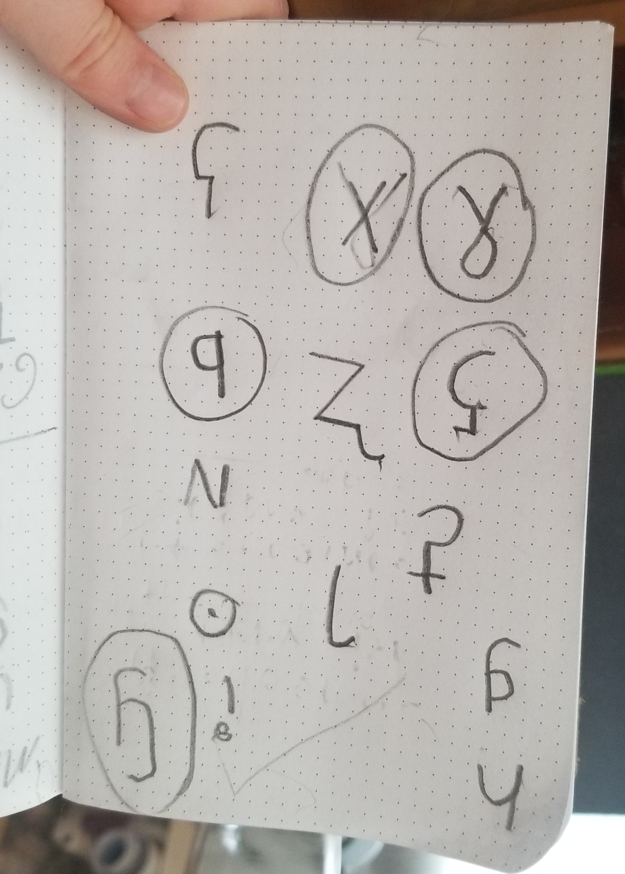
For today's class credit: choose 5 non-English consonants before class & upload their symbols in your Discord group.
https://www.ipachart.com/

Slide 27
Linguistics 200, Week 4
Day 2: Consonants

Slide 28
Last Time
Consonant Properties:
Voicing
Place
Manner

Slide 29
Review
Last time you started working on the Dorgon consonant system

Slide 30
Today
We'll be examining how my older son & I fashioned our C inventory for Metra
We'll discuss "rules" for fashioning a C system
With these in mind, we'll return to the Dorgon inventory
We'll finish up by beginning work on your consonant inventories

Slide 31
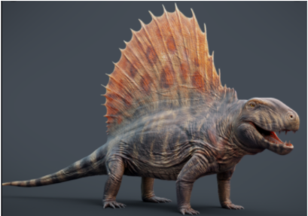
Metra Phonology - Starting with 5 consonants

Slide 32
 | Bilabial | Labiodental | Interdental | Alveolar | Alveopalatal | Palatal | Velar | Uvular | Glottal
Stop voiceless voiced |  |  |  |  |  |  |  | q
Nasal
Fricative voiceless voiced |  |  |  |  |  | ç | x ɧ ɣ
Affricate voiceless voiced
Glide
Liquid

Slide 33
Choose 5 non-English consonants
https://www.ipachart.com/

Slide 34
Create a consonant chart that includes the five, non-English sounds you chose.

Slide 35
From “Chapter 4: Consonants”
All languages utilize stops in their consonant inventories. Nearly all languages have bilabial sounds like /p/, alveolar sounds like /t/, and velar sounds like /k/.
If voicing does not matter within the inventory of stops, affricates, and fricatives, the voiceless sound is chosen. So you would have /p t k/, not /b d g/.
The most common fricative is /s/.
Nearly all languages have nasals, with /m/ and /n/ being the most common.
Nearly all languages have /r/ and /l/, though some (most notably East Asian languages) do not contrast the two, typically merging them to /r/.
Many languages have the glides /w/ and /y/, though these are often absent, especially between vowels.
Go back to your other consonant choices to see if they can help fill in the gaps.

Slide 36
 | Bilabial | Labiodental | Interdental | Alveolar | Alveopalatal | Palatal | Velar | Uvular | Glottal
Stop voiceless voiced |  |  |  |  |  |  |  | q
Nasal
Fricative voiceless voiced |  |  |  |  |  | ç | x ɧ ɣ
All languages utilize stops in their consonant inventories. Nearly all languages have bilabial sounds like /p/, alveolar sounds like /t/, and velar sounds like /k/.

Slide 37
 | Bilabial | Labiodental | Interdental | Alveolar | Alveopalatal | Palatal | Velar | Uvular | Glottal
Stop voiceless voiced | p |  |  | t |  |  | k | q
Nasal
Fricative voiceless voiced |  |  |  |  |  | ç | x ɧ ɣ
If voicing does not matter within the inventory of stops, affricates, and fricatives, the voiceless sound is chosen. So you would have /p t k/, not /b d g/.

Slide 38
 | Bilabial | Labiodental | Interdental | Alveolar | Alveopalatal | Palatal | Velar | Uvular | Glottal
Stop voiceless voiced | p |  |  | t |  |  | k | q
Nasal
Fricative voiceless voiced |  |  |  | s |  | ç | x ɧ ɣ
The most common fricative is /s/.

Slide 39
 | Bilabial | Labiodental | Interdental | Alveolar | Alveopalatal | Palatal | Velar | Uvular | Glottal
Stop voiceless voiced | p |  |  | t |  |  | k | q
Nasal | m |  |  | n |  |  | ŋ | ɴ
Fricative voiceless voiced |  |  |  | s |  | ç | x ɧ ɣ
Nearly all languages have nasals, with /m/ and /n/ being the most common.

Slide 40
 | Bilabial | Alveolar | Retroflex | Palatal | Velar | Uvular
Stop voiceless implosive | p ɓ | t ɗ |  |  | k ɠ | q ʛ
Nasal | m | n |  |  | ŋ | ɴ
Fricative voiceless voiced |  | s |  | ç | x ɧ ɣ
Glide | w |  |  | y
Liquid |  |  | ɭ |  |  | ʀ
Nearly all languages have /r/ and /l/, though some (most notably East Asian languages) do not contrast the two, typically merging them to /r/.

Slide 41
 | Bilabial | Alveolar | Retroflex | Palatal | Velar | Uvular
Stop voiceless implosive | p ɓ | t ɗ |  |  | k ɠ | q ʛ
Nasal | m | n |  |  | ŋ | ɴ
Fricative voiceless voiced |  | s |  | ç | x ɧ ɣ
Glide | w |  |  | j
Liquid |  |  | ɭ |  |  | ʀ
Many languages have the glides /w/ and /j/, though these are often absent, especially between vowels.

Slide 42
Return to Dorgon – Any modifications needed?​
 | Bilabial | Labiodental | Interdental | Alveolar | Alveopalatal | Palatal | Velar | Uvular | Glottal
Stop | b |  |  | d |  | c | k g
Nasal | m |  |  | n
Affricate | pf
Fricative |  |  | θ | s z |  | ç | x
Liquid |  |  |  | r, l

Slide 43
Return to Dorgon – Any modifications needed?
All languages utilize stops in their consonant inventories. Nearly all languages have bilabial sounds like /p/, alveolar sounds like /t/, and velar sounds like /k/.
If voicing does not matter within the inventory of stops, affricates, and fricatives, the voiceless sound is chosen. So you would have /p t k/, not /b d g/.
The most common fricative is /s/.
Nearly all languages have nasals, with /m/ and /n/ being the most common.
Nearly all languages have /r/ and /l/, though some (most notably East Asian languages) do not contrast the two, typically merging them to /r/.
Many languages have the glides /w/ and /y/, though these are often absent, especially between vowels.

Slide 44
Dorgon Consonant System
 | Bilabial | Labiodental | Interdental | Alveolar | Alveopalatal | Palatal | Velar | Uvular | Glottal
Stop | b |  |  | d |  | c | k g
Nasal | m |  |  | n
Affricate | pf
Fricative |  |  | θ | s z |  | ç | x
Liquid |  |  |  | r, l
Follow the rules above: how would you modify the existing system?

Slide 45
Return to Dorgon – Any modifications needed?​
 | Bilabial | Interdental | Alveolar | Palatal | Velar
Stop | b |  | d | c | k g
Nasal | m |  | n | ɳ | ŋ
Affricate | pf | tθ | ts | cç | k
Fricative |  | θ | s | ç | kx
Liquid |  |  | r, l
All languages utilize stops in their consonant inventories. Nearly all languages have bilabial sounds like /p/, alveolar sounds like /t/, and velar sounds like /k/.

Slide 46
Return to Dorgon – Any modifications needed?​
2. If voicing does not matter within the inventory of stops, affricates, and fricatives, the voiceless sound is chosen. So you would have /p t k/, not /b d g/.

Slide 47
Return to Dorgon – Any modifications needed?​
3. The most common fricative is /s/.

Slide 48
Return to Dorgon – Any modifications needed?​
4. Nearly all languages have nasals, with /m/ and /n/ being the most common.

Slide 49
Return to Dorgon – Any modifications needed?​
5. Nearly all languages have /r/ and /l/, though some (most notably East Asian languages) do not contrast the two, typically merging them to /r/.

Slide 50
Return to Dorgon – Any modifications needed?​
6. Many languages have the glides /w/ and /y/, though these are often absent, especially between vowels.

Slide 51
Now – your language
Return to your five favorite sounds
Identify any other consonants in your names created for component 1
Describe all of your consonants featurally
Align them in a feature chart
Flesh out the system with common sounds following the six 'rules'

Slide 52
Your Language's Consonant Inventory!
 | Bilabial | Labiodental | Interdental | Alveolar | Alveopalatal | Palatal | Velar | Uvular | Pharyngeal | Glottal
Stop
Nasal
Affricate
Fricative
Liquid
Glide

Slide 53
Linguistics 200, Week 4
Day 3: Finishing Consonats, Beginning Vowels

Slide 54
Component 1 & moving forward
Grades for Component 1
Final Project & past components

Slide 55
Dorgon – with additional modifications (why?)
 | Bilabial | Interdental | Alveolar | Palatal | Velar
Stop | p b |  | t d | c ɟ | k g
Nasal | m |  | n | ɳ | ŋ
Affricate | pf |  | ts
Fricative |  | θ (ð) | s (z) | ç (ʝ) | x (ɣ)
Liquid |  |  | r, l

Slide 56
Today
Keep working on your C system
Overview of Vowels

Slide 57
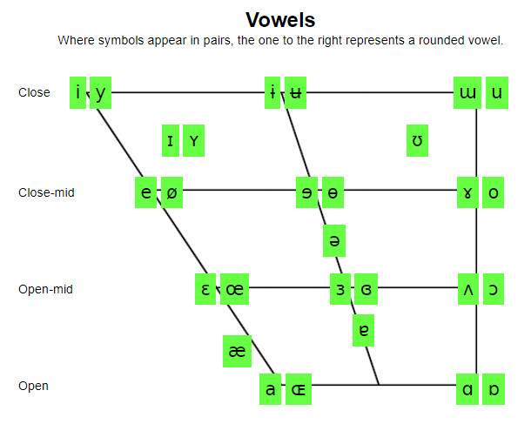
For class credit: before next time
Pick 3 non-English vowels that you like.
https://www.ipachart.com/

Slide 58
Consulting with your groupmates, finish up your C system

Slide 59
For class credit: explore!
Pick 3 non-English vowels that you like.
https://www.ipachart.com/

